Slide 1
Stationarity
Mean (Recap)
Variance (pp 290 – 293 Text Book)

Slide 2
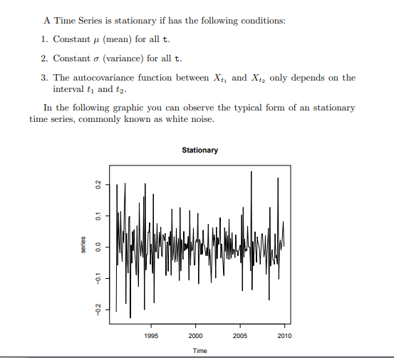
Stationarity of Time Series

Slide 3
Why is stationarity important?
In the most intuitive sense, stationarity means that the statistical properties of a process generating a time series do not change over time.
It does not mean that the series does not change over time, just that the way it changes does not itself change over time.
The algebraic equivalent is thus a linear function, perhaps, and not a constant one; the value of a linear function changes as 𝒙 grows, but the way it changes remains constant — it has a constant slope; one value that captures that rate of change.
Why is this important? First, because stationary processes are easier to analyze.

Slide 4
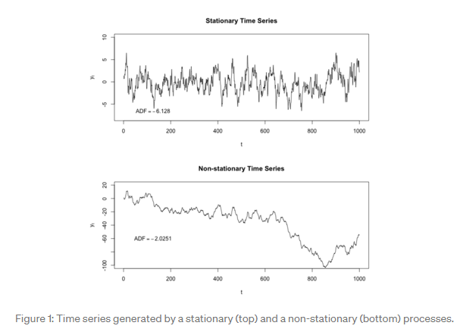

Slide 5
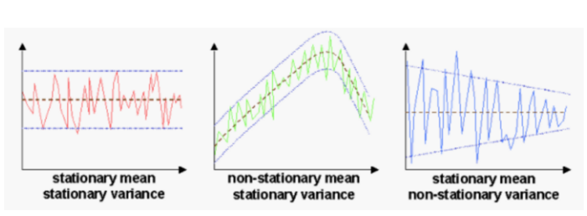

Slide 6
A stationary time series
A stationary time series is one whose properties do not depend on the time at which the series is observed.
Thus, time series with trends, or with seasonality, are not stationary — the trend and seasonality will affect the value of the time series at different times.
On the other hand, a white noise series is stationary — it does not matter when you observe it, it should look much the same at any point in time.
In general, a stationary time series will have no predictable patterns in the long-term. Time plots will show the series to be roughly horizontal (although some cyclic behaviour is possible), with constant variance.

Slide 7
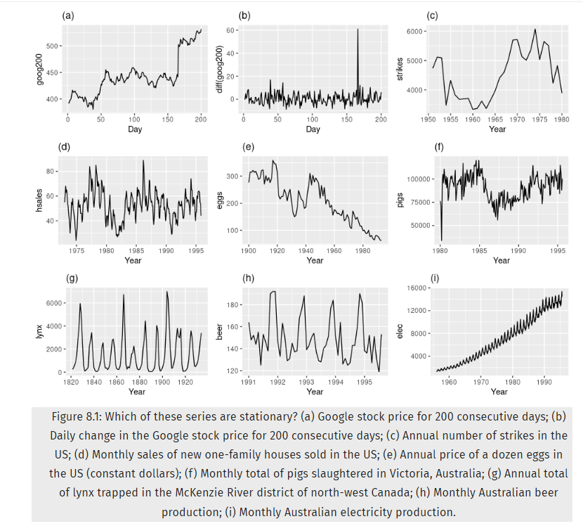
Which ones are stationary?
Seasonality rules out series (d), (h) and (i).
Trends and changing levels rules out series (a), (c), (e), (f) and (i).
Increasing variance also rules out (i).
That leaves only (b) and (g) as stationary series.

Slide 8
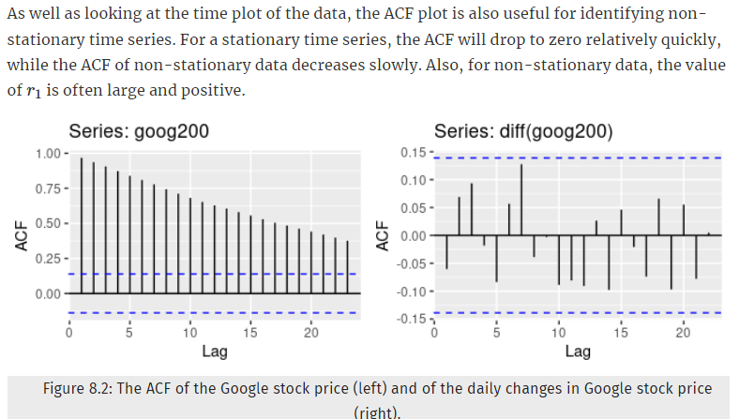
ACF Plots
The ACF of the differenced Google stock price looks just like that of a white noise series.
There are no autocorrelations lying outside the 95% limits.
This suggests that the daily change in the Google stock price is essentially a random amount which is uncorrelated with that of previous days.

Slide 9
To make series stationary Differencing / Taking Logs
Differencing
Note that the Google stock price was non-stationary in panel (a), but the daily changes were stationary in panel (b).
This shows one way to make a non-stationary time series stationary — compute the differences between consecutive observations. This is known as differencing.
Log Transforms
Transformations such as logarithms can help to stabilise the variance of a time series.
Differencing can help stabilise the mean of a time series by removing changes in the level of a time series, and therefore eliminating (or reducing) trend and seasonality.

Slide 10
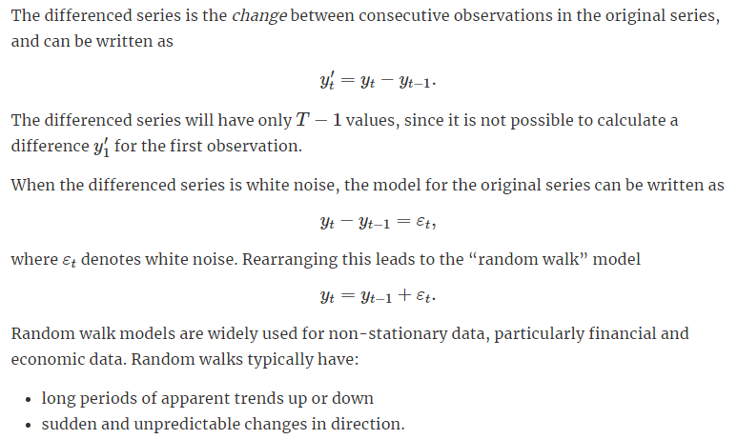
Random Walk Model
The forecasts from a random walk model are equal to the last observation, as future movements are unpredictable, and are equally likely to be up or down.

Slide 11
How to test for stationarity?
The stationarity of a series can be established by looking at the plot of the series like we did earlier.
Another method is to split the series into 2 or more contiguous parts and computing the summary statistics like the mean, variance and the autocorrelation. If the stats are quite different, then the series is not likely to be stationary.
Nevertheless, you need a method to quantitatively determine if a given series is stationary or not. This can be done using statistical tests called ‘Unit Root Tests’.
There are multiple variations of this, where the tests check if a time series is non-stationary and possess a unit root.

Slide 12
Unit root tests
One way to determine more objectively whether differencing is required is to use a unit root test.
These are statistical hypothesis tests of stationarity that are designed for determining whether differencing is required.
A number of unit root tests are available, which are based on different assumptions and may lead to conflicting answers.

Slide 13
How to test for stationarity? Unit root tests
Multiple implementations of Unit Root tests:
Augmented Dickey Fuller test (ADF Test)
Kwiatkowski-Phillips-Schmidt-Shin – KPSS test (trend stationary)
Philips Perron test (PP Test)
ADF Test:
The most commonly used is the ADF test, where the null hypothesis is the time series possesses a unit root and is non-stationary.
So, id the P-Value in ADH test is less than the significance level (0.05), you reject the null hypothesis (and say stationary).
The KPSS test:
The null hypothesis and the P-Value interpretation is just the opposite of ADH test. The below code implements these two tests using statsmodels package in python.

Slide 14
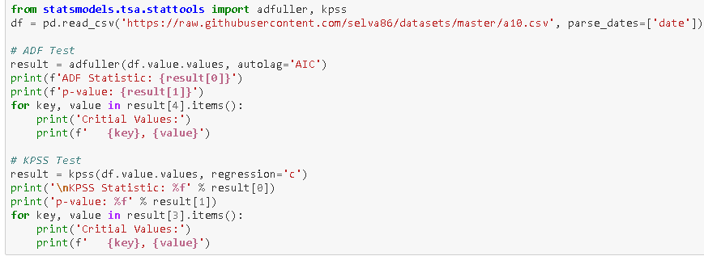
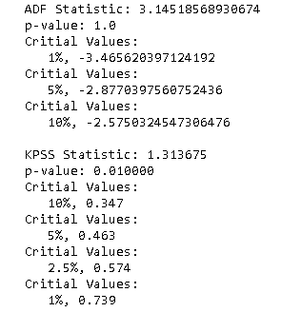
How to test for stationarity?
A non-stationary series
null hypothesis is the time series possesses a unit root and is non-stationary (here do not reject the NULL).
null hypothesis is the time series possesses a unit root and is stationary (here reject the NULL).
Consequently, small p-values (e.g., less than 0.05) suggest that differencing is required.

Slide 15
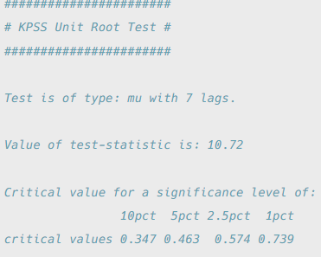
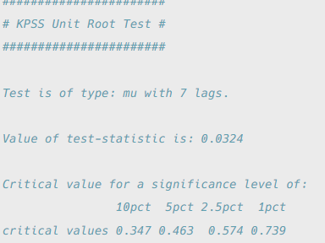
Test for stationarity: Before and After Differencing
KPSS Test on Google stock price
The test statistic is much bigger than the 1% critical value, indicating that the null hypothesis is rejected.
That is, the data are not stationary. We can difference the data, and apply the test again.
KPSS Test on differences in Google stock price.
This time, the test statistic is tiny, and well within the range we would expect for stationary data. So we can conclude that the differenced data are stationary.
This process of using a sequence of KPSS tests to determine the appropriate number of first differences can be carried out by functions in R or Python

Slide 16
Some examples of the different types of series that need be transformed to obtain a stationary series (prior to applying forecasting techniques)

Slide 17
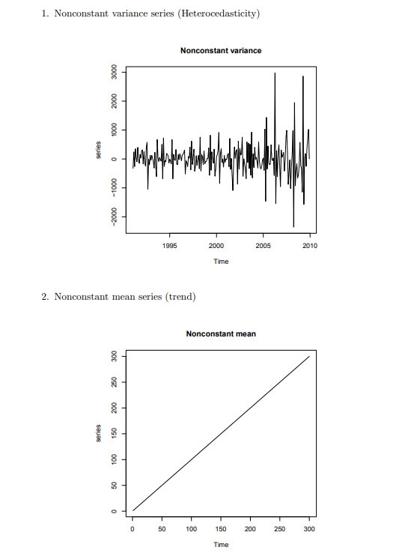
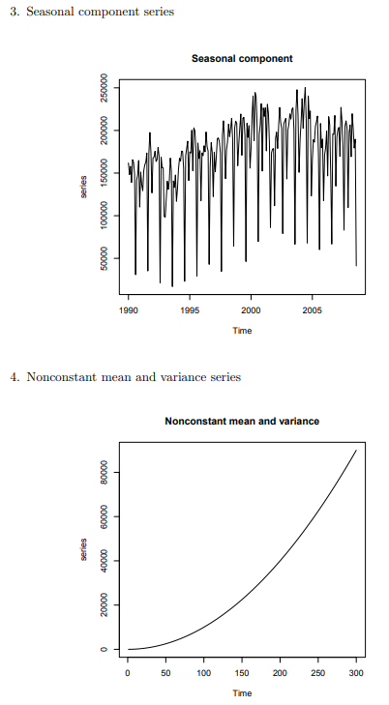
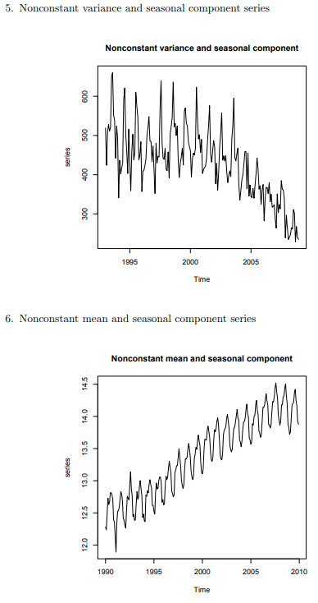

Slide 18
Handling Variance Stationarity

Slide 19
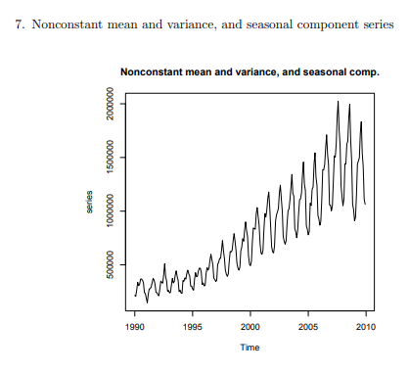
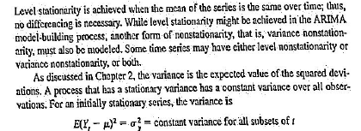

Slide 20
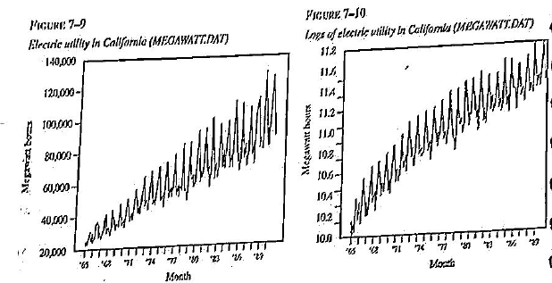
Variance Stationarity
Variance Non stationary
Logarithmic or Power transforms may make it stationery

Slide 21
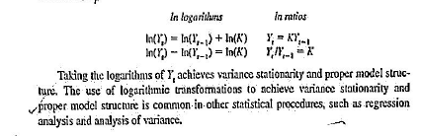
Log Transforms to achieve Variance stationarity

Slide 22
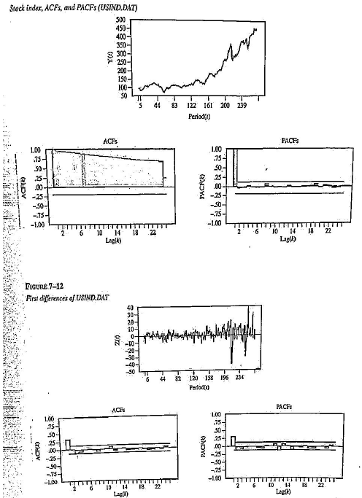
US Stock price Index Non stationery in level as well as variance First diff is also variance non stationery (Fig 7.12) => transform needed

Slide 23
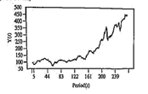
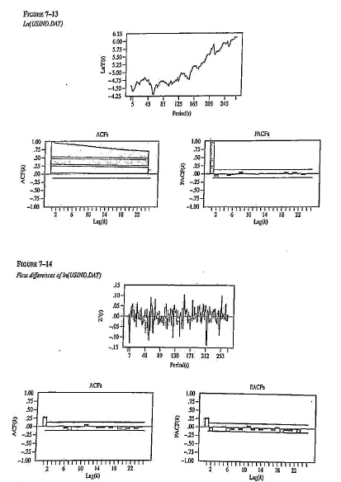
Original series – both level and variance non-stationary
2 steps
Step1-Log of Y_{t} taken (non stationary in level, but variance stationary
Step2- Diff and make it level stationary
Make it level stationary –
take first diff of Log of Y_{t}
All ACFs/ PACFs except at lag1 are insignificant

Slide 24
Thank You

